Slide 1
Chapter 3
3-phase Induction Motors

Slide 2
Introduction

Slide 3
The polyphase induction motor is the most widely used motor in industrial and commercial applications.
There are two types, namely
  slip ring induction motor and
  squirrel-cage induction motor.

Slide 4
The squirrel-cage is more common because of its
  low-cost,
  high reliability and
  high efficiency over a wide range of power outputs.

Slide 5
From a constant frequency source, the squirrel-cage motor operates as a constant speed drive.
For continuous speed control over a wide speed range, it is supplied from a solid-state variable-frequency converter.

Slide 6
Construction

Slide 7
A three-phase induction motor has two main parts:
  a stationary stator and
  a revolving rotor.
The rotor is separated from the stator by a small air-gap which ranges from 0.4 mm to 4 mm depending on the power rating of the motor.

Slide 8
Stator
It consists of a steel frame which encloses a hollow, cylindrical core made up of stacked laminations.
A number of slots are punched uniformly round the gap surface of the core.
These slots carry the stator 3-phase winding.

Slide 9
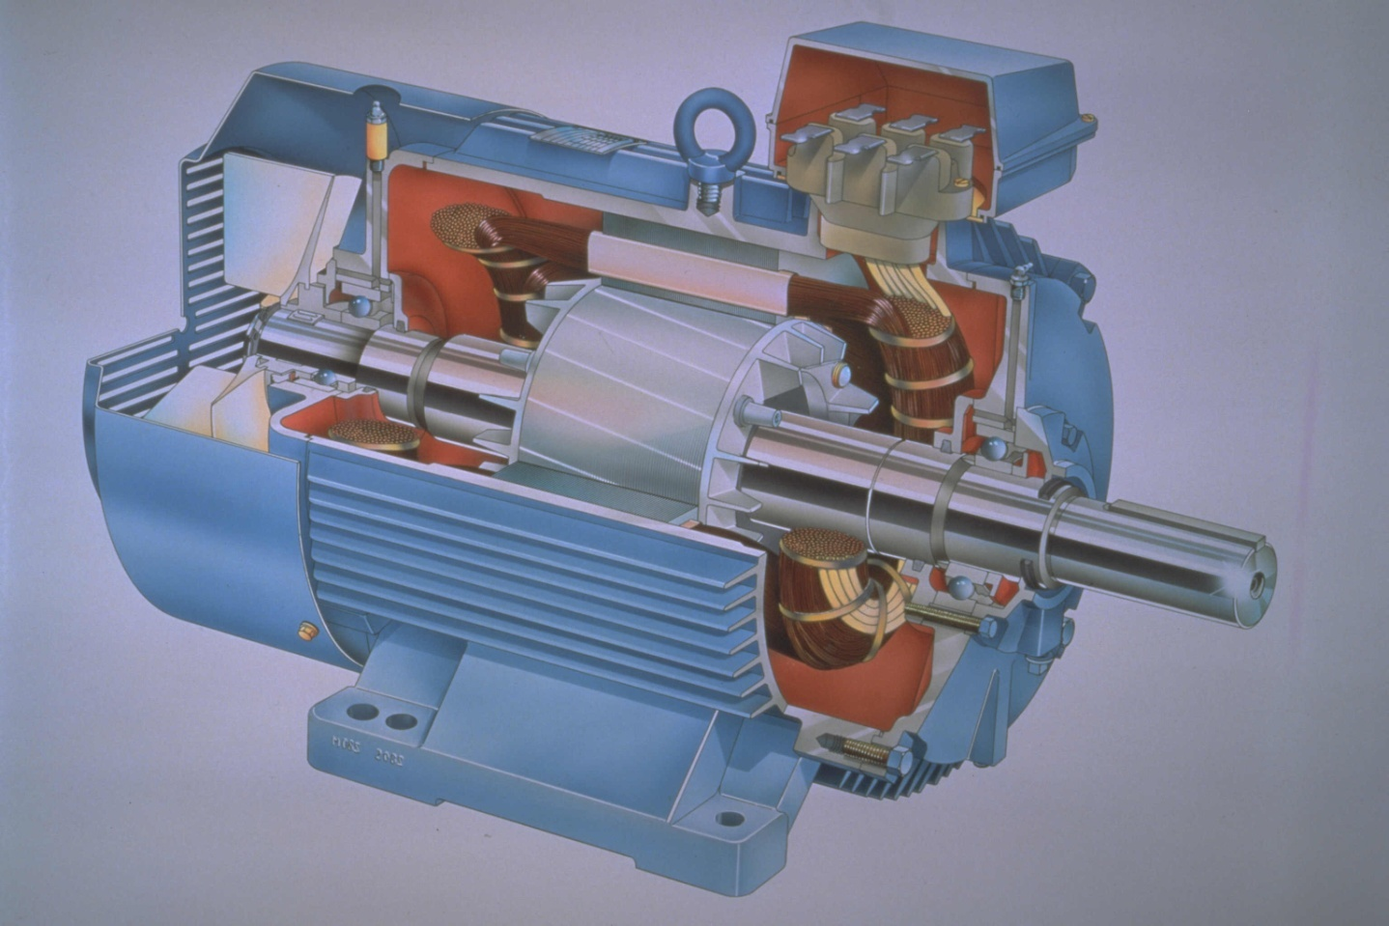
Induction Motors

Slide 10
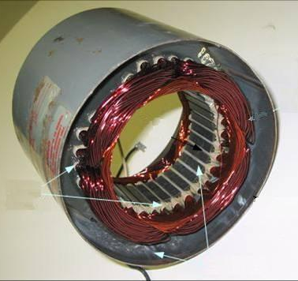
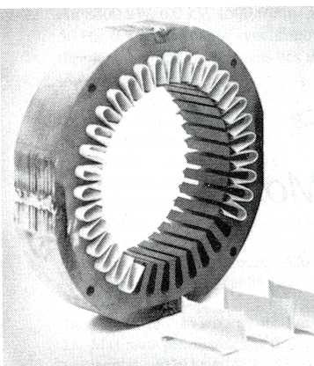
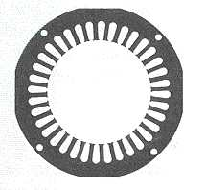
The core laminations are
  insulated from one another to reduce eddy current loss
  made of silicon steel 0.3 to 0.5mm thick

Slide 11
Rotor
It is also composed of punched laminations.
These are carefully stacked to create a series of rotor slots to provide space for the rotor winding.
Two types of rotor windings are used.

Slide 12
The type of winding gives rise to two main classes of motors:
  squirrel-cage induction motors and
  wound-rotor or slip-ring induction motors.

Slide 13
Squirrel-cage rotor

Slide 14
Bare copper bars, slightly longer than the rotor are pushed into the rotor slots.
The opposite ends are welded to two copper end-rings, so that all bars are short-circuited together.

Slide 15
In small (10 kW or less) and medium-size motors (between 10 kW and 1000 kW), the bars and end-rings are made of die-cast aluminium moulded together to form an integral block.

Slide 16
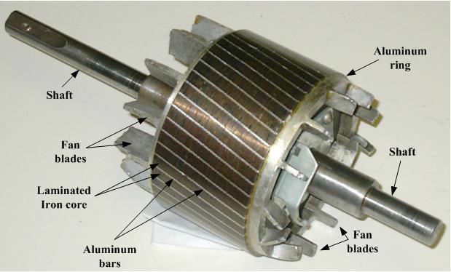

Slide 17
Wound or slip-ring rotor

Slide 18
The rotor slots carry three-phase winding similar to the one on the stator.
The windings are usually connected in star.
The terminals are connected to three-slip rings which turn with the rotor.

Slide 19
The revolving slip-rings and associated stationary brushes enable us to connect external resistors in series with the rotor windings.
The rotor of an induction motor could be wound for a number of phases different from that for the stator.

Slide 20
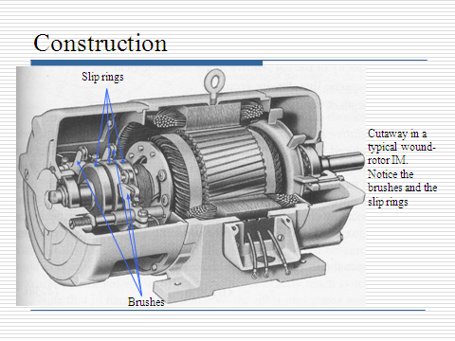

Slide 21
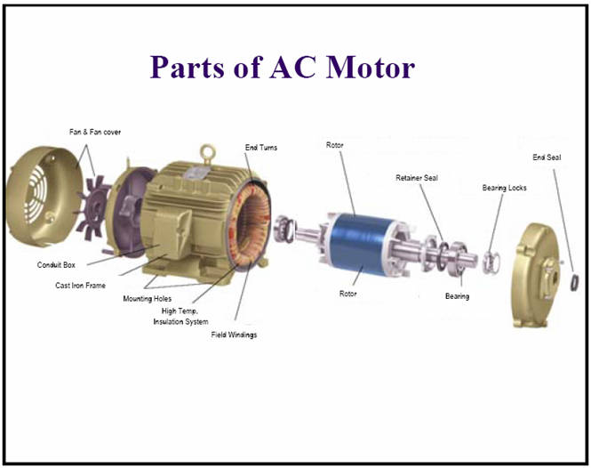

Slide 22
Principle of operation of the
induction motor

Slide 23
A rotating magnetic field is set up when a 3-phase voltage is applied to the stator of an induction motor.
The rotating field cuts across the rotor conductors and induces a voltage in all of them.

Slide 24
The induced voltage causes large currents to flow in the conductors and these interact with the magnetic field to produce a torque.
The torque, according to Lenz’s law, drags the rotor along in the direction of the revolving field.

Slide 25
According to Lenz’s law, an induced emf will tend to set up a current whose magnetic field will oppose the motion or change of flux responsible for inducing that emf.

Slide 26
Acceleration of the rotor - slip

Slide 27
As the motor picks up speed, the relative velocity of the field with respect to the rotor diminishes progressively.
This causes both the value and the frequency of the rotor induced voltage to decrease because the rotor conductors are cut more slowly.

Slide 28
The rotor current, very large at first, decreases rapidly as the motor picks up speed.
The speed will continue to increase, but it will never catch up with the rotating field.

Slide 29
In effect, if the rotor should turn at the same speed as the field, the relative velocity would be zero and the induced voltage and current would fall to zero.
Under these conditions, the torque acting on the rotor would also become zero and friction and windage would immediately cause the rotor to slow down.

Slide 30
The rotor speed must always be slightly less than the speed of the revolving field (called synchronous speed) so as to produce a current in the rotor bars sufficiently large to overcome the braking torque.
At no load the difference in speed between the rotor and field (called slip) is very small, usually less than 0.1 % of synchronous speed.

Slide 31
Production of rotating field by 3-phase currents in 3-phase winding

Slide 32
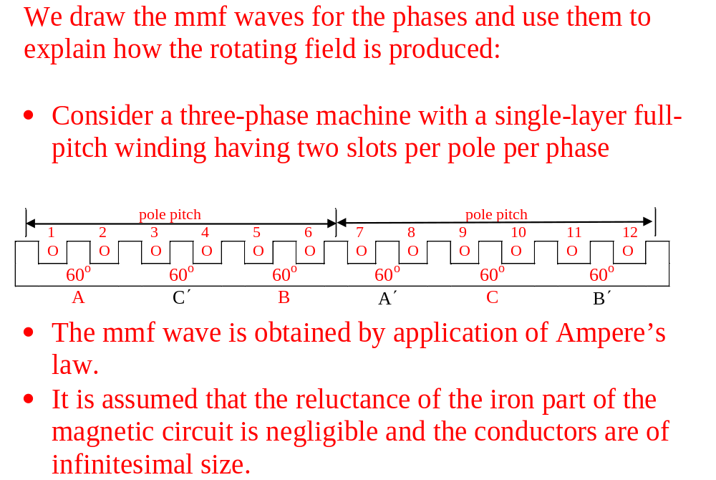

Slide 33
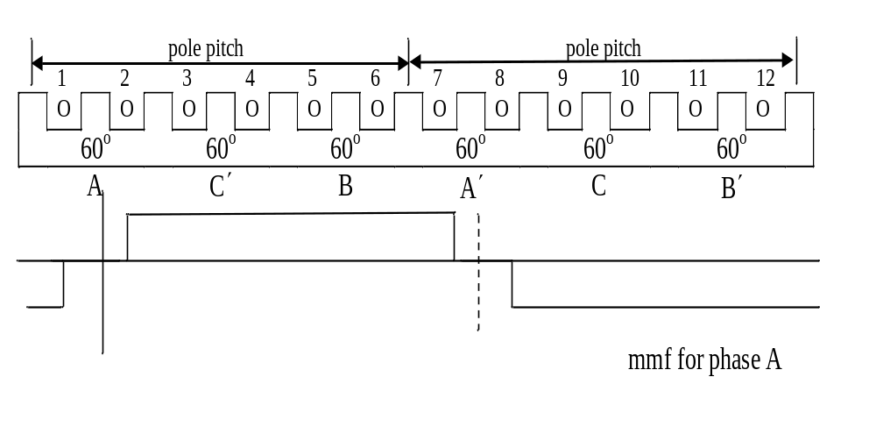

Slide 34
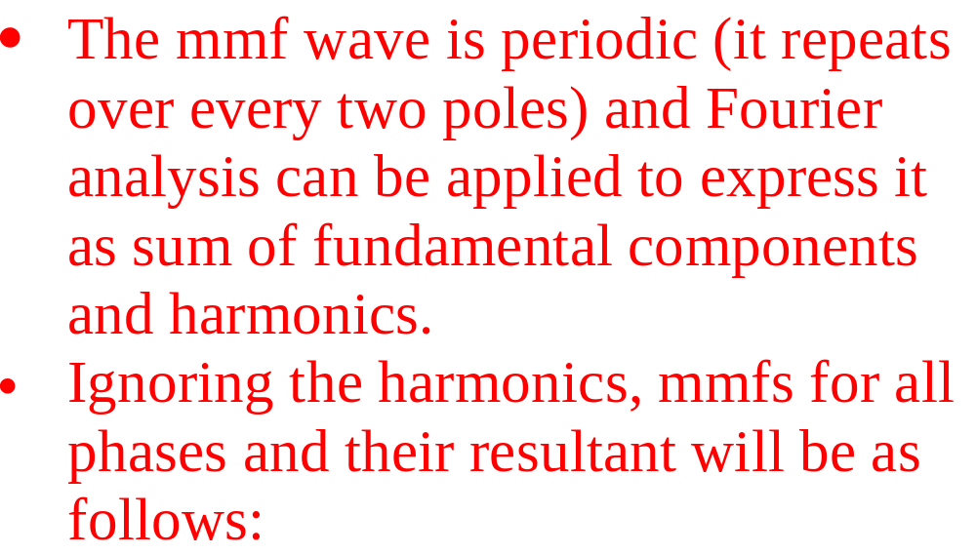

Slide 35
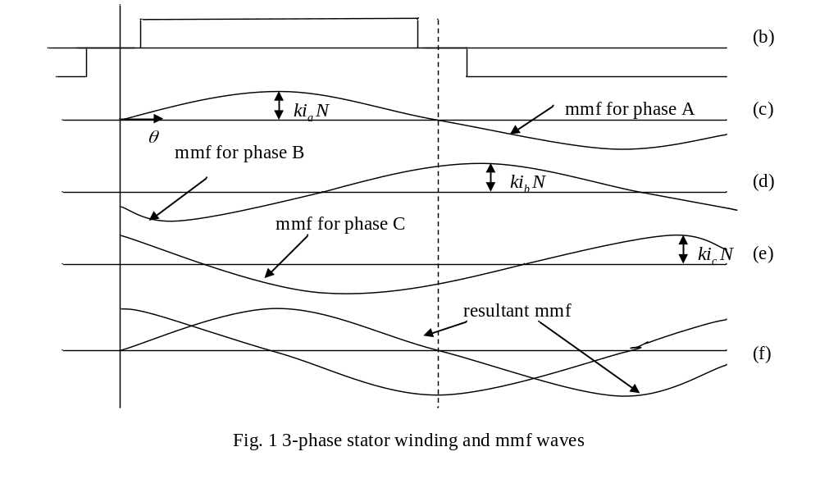

Slide 36
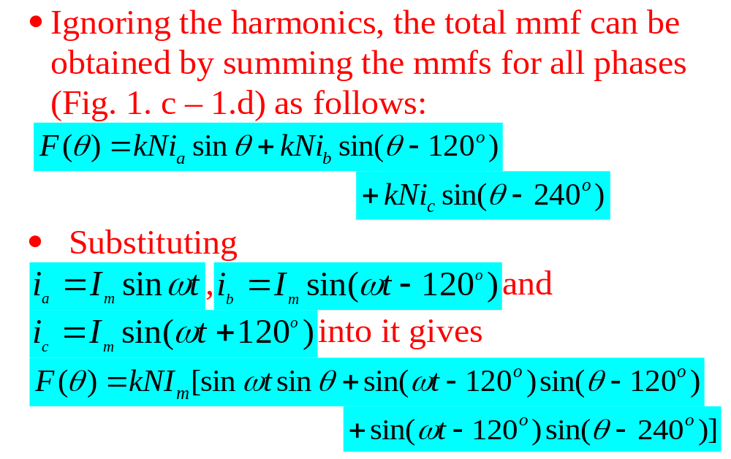

Slide 37
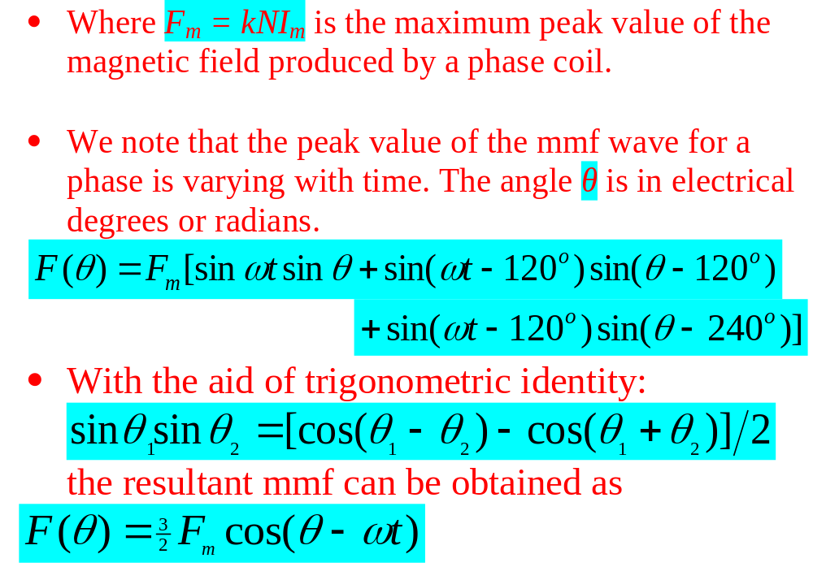

Slide 38
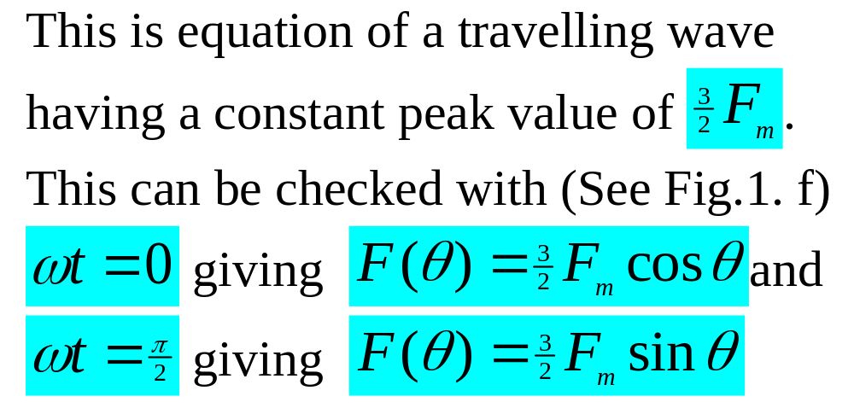

Slide 39
Speed of mmf wave

Slide 40
The speed of the wave is obtained by equating the argument of the cosine to a constant and differentiating it with respect to time.
Thus for a 2p-pole machine, the speed of rotation (called synchronous speed) defined as ω_{s} = dθ_{mech}/dt is obtained as follows:

Slide 41
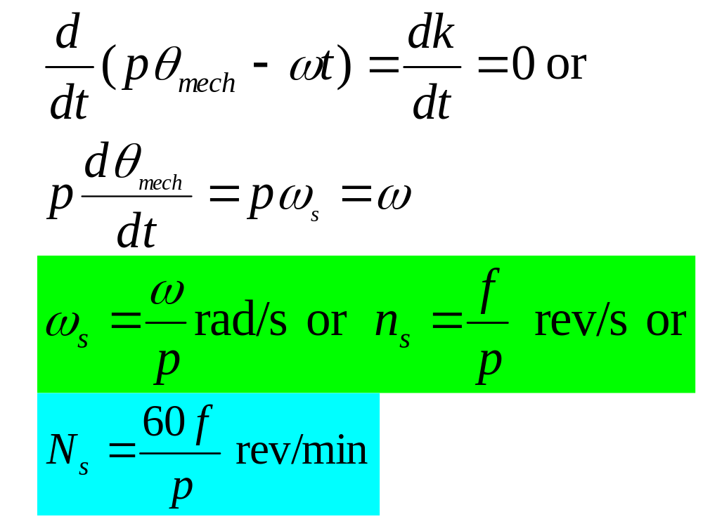

Slide 42
Definition of slip

Slide 43
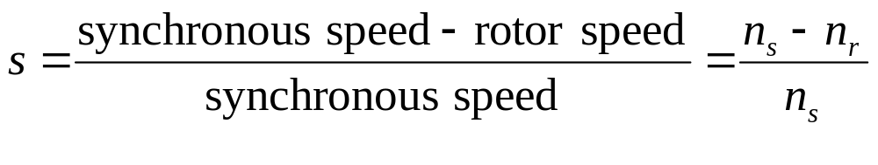
The slip, s of an induction motor is defined as
s =1 when the rotor is locked or at standstill.
On no load s is usually less than 0.001 and

Slide 44
At full load s is usually less than 0.005 for large motors (1000 kW and more) and less than 0.03 for small motors (10 kW or less).
For this reason induction motors are considered to be constant speed machines.

Slide 45
Rotor frequency

Slide 46
The frequency of the voltage induced in the rotor depends upon the slip.
It is given by
f_{r} = sf
where f = frequency of the source connected to the stator.

Slide 47
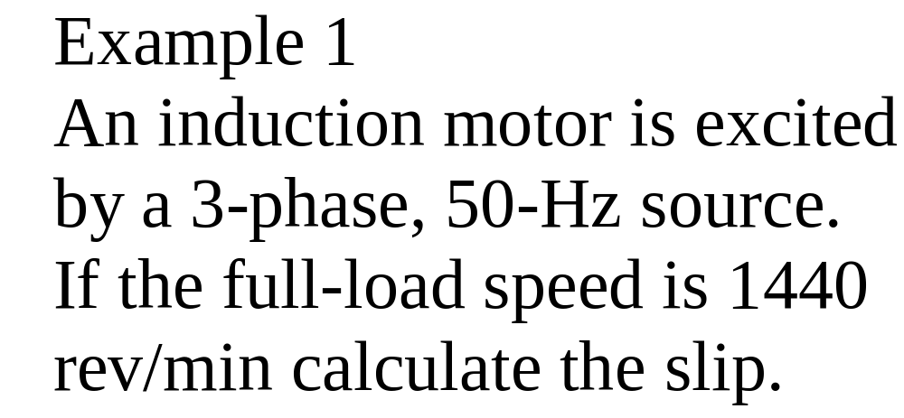

Slide 48
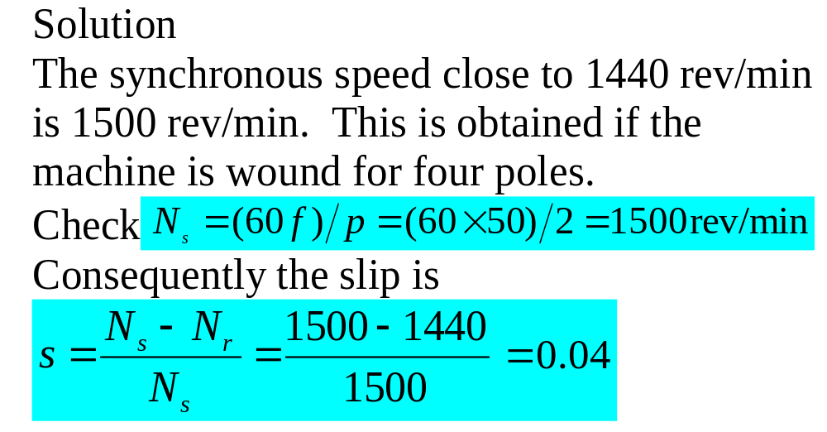

Slide 49
Rotor mmf

Slide 50
The polyphase winding of the rotor carries a polyphase current.
Thus the rotor also produces a rotating field.
The rotor and stator magnetic axes move at the same speed (with respect to the stator) and in the same direction.

Slide 51
Were it not so, the machine would not be self-maintaining in rotation.
The stator and rotor windings must be arranged to have the same number of poles, so that their mmf waves can combine to form a resultant rotating mmf wave.

Slide 52
A wound-rotor would therefore have to be wound to have the same number of poles as the stator.
A squirrel cage can be viewed as a polyphase winding.
The winding has the advantage of adapting itself readily to any number of the stator poles.

Slide 53
Generally with C individual rotor conductors, one per slot, the number of rotor phases is m = C/2p, each phase winding having a single turn.
The number of poles of the rotor is entirely determined by the stator.

Slide 54
Active power flow through induction motor

Slide 55
The power flow diagram below indicates what becomes of the active power P_{e} that is drawn by the stator of an induction motor.
P_{e} = input power
P_{js} = stator copper loss
P_{fs} = stator iron loss

Slide 56
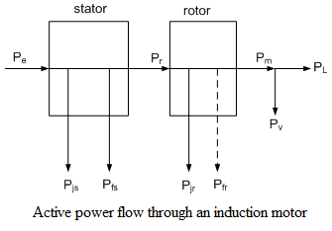

Slide 57
P_{r} = power transferred from stator
to rotor
P_{jr} = rotor copper loss
P_{fr} = rotor iron loss (negligible
because f_{r} ≈ 0)
P_{m} = gross output power
P_{v} = friction and windage loss

Slide 58
P_{L} = shaft power
Gross torque = gross output power /
motor speed
Useful or shaft torque = shaft power
/motor speed
Loss torque or no load torque =
friction and windage loss /
motor speed

Slide 59
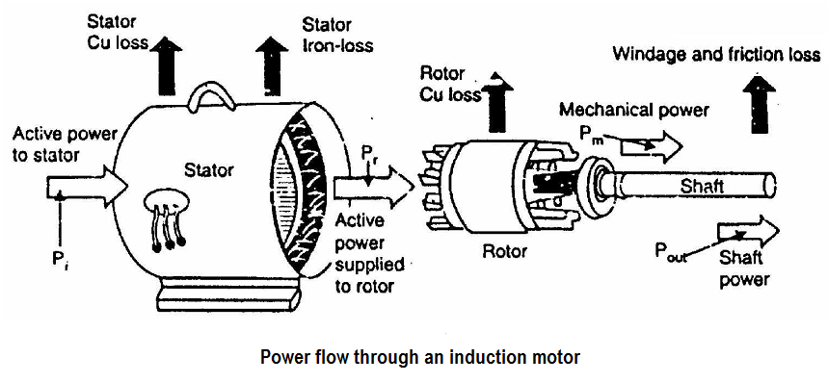

Slide 60
Torque and output power equations

Slide 61
The power transferred from the stator to the rotor is given by
P_{r} = T_{e}ω_{s}
The gross mechanical power is given by
P_{m} = T_{e}ω_{r}
T_{e} is the electromagnetic or gross torque developed by the motor.

Slide 62
If the rotor iron loss is neglected then
P_{jr} = P_{r} – P_{m}
= [(ω_{s} – ω_{r})/ ω_{s}] T_{e} ω_{s}
= s P_{r} ,i.e.
P_{jr} = s P_{r} and
P_{m} = P_{r} – P_{jr} = (1-s)P_{r}

Slide 63
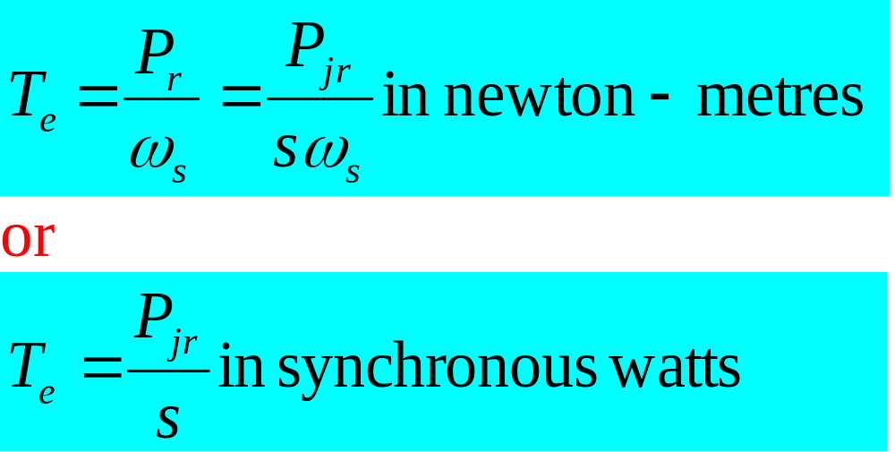
Also the electromagnetic or gross torque can be expressed as

Slide 64
Example 2
The power supplied to a three-phase induction motor is 40 kW and the corresponding stator losses are 1.5 kW, calculate
the total mechanical power developed and the rotor loss when the slip is 0.04 per unit,

Slide 65
the output power of the motor if the friction and windage loss is 0.8 kW and
the efficiency of the motor.
Neglect the rotor iron loss.

Slide 66
Solution:
Input power to rotor,
P_{r} = 40 – 1.5 = 38.5 kW
Rotor copper loss
P_{jr} = sP_{r} = 0.04 x 38.5 = 1.54 kW
Therefore the total mechanical
power developed P_{m} = P_{r} –P_{jr}
= 38.5 – 1.54 = 36.96 kW

Slide 67
(b) Output power of motor
P_{L} = P_{m} – P_{v}
= 36.96 – 0.8 = 36.16 kW
(c) Efficiency of motor
η = P_{L}/P_{e}
= 36.16/40
= 0.904
= 90.4 %

Slide 68
Example 3
If the speed of the motor of Example 2 is reduced to 40 % of its synchronous speed by means of external rotor resistors, calculate
the total rotor I²R loss and
the efficiency.

Slide 69
Assume that
the torque and the stator losses remain unaltered and
also the increase in the iron loss is equal to the reduction in the friction and windage loss.

Slide 70
Solution
(a) New slip s = (N_{s}-N_{r})/N_{s}
= (100 – 40)/100
= 0.6 pu
and input power to rotor P_{r} = 38.5 kW because torque unaltered.
Total rotor copper loss
P_{jr} = sP_{r} = 0.6 x 38.5 = 23.1 kW

Slide 71
(b)Total losses in rotor
P_{jr} + P_{v} = 23.1 +0.8 = 23.9 kW
Therefore output power of motor
= P_{r} – total rotor losses
= 38.5 – 23.9 = 14.6 kW
Efficiency of motor = output power/ input power = output power/ (stator losses + P_{r}) = 14.6/40 = 36.5 %

Slide 72
Stator and rotor induced voltages
Conditions with rotor winding stationary and open-circuited
When a voltage is applied to the stator, it takes current which produces a rotating mmf.
The stator rotating mmf then produces a rotating flux.

Slide 73
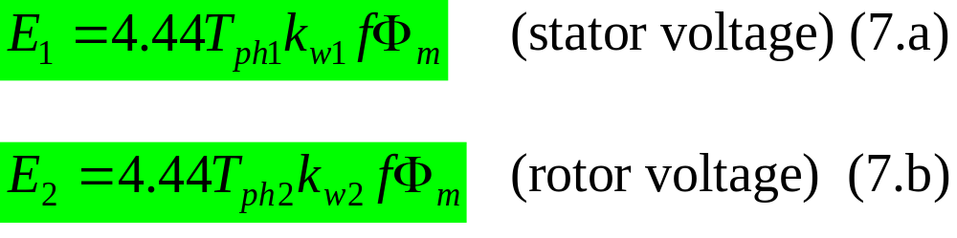
Conditions with rotor winding stationary and open-circuited cont’d
A major part of the flux links the rotor and the remainder is a leakage flux.
The mutual flux induces phase voltages:

Slide 74
Rotor winding closed
When the rotor winding is closed, the voltage induced in the rotor by the mutual flux causes current to circulate.
Whether the rotor is locked or released, the mmf of the rotor rotating also at synchronous speed, tend to demagnetize the machine, so that the stator takes equal and opposite mmf component as in transformers.

Slide 75
Stator and rotor induced voltages
Rotor winding closed cont’d
There is established a rotor leakage flux, a reduced mutual flux and an increased stator leakage flux.

Slide 76
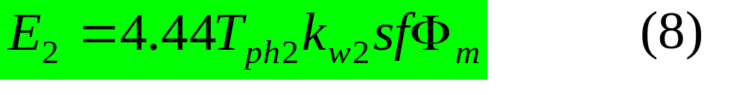
Rotor winding closed cont’d
With the rotor released (the general case) the induced emf in the rotor becomes:
At standstill s = 1 and the induced emf is given by (7.b).
However, the mutual flux is very small.
The mutual flux in the equation is about 50 % of no load value

Slide 77
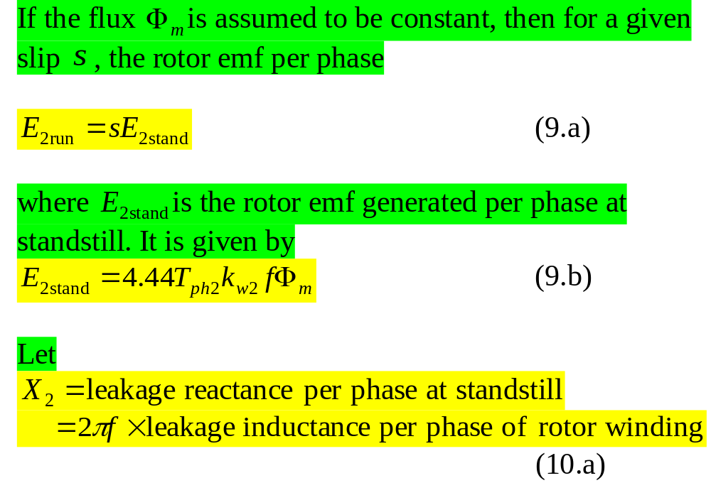
Torque calculations assuming constant mutual flux

Slide 78
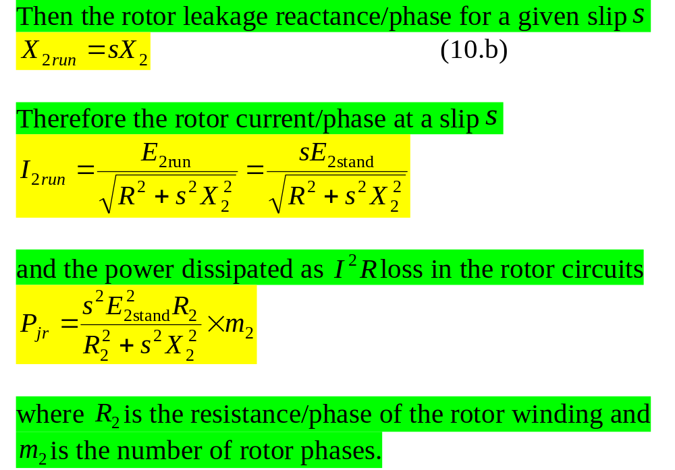
Torque calculations assuming constant mutual flux

Slide 79
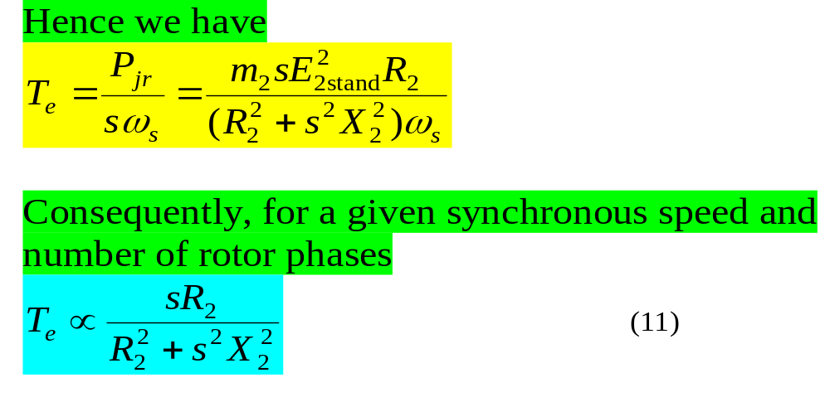
Torque calculations assuming constant mutual flux

Slide 80
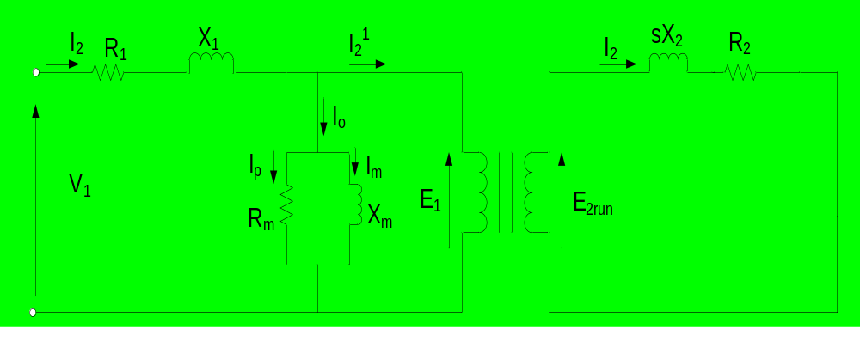
Exact equivalent circuit
The equivalent circuit is arrived at in the same way as for transformer.
The circuit on the single-phase or per phase basis is

Slide 81
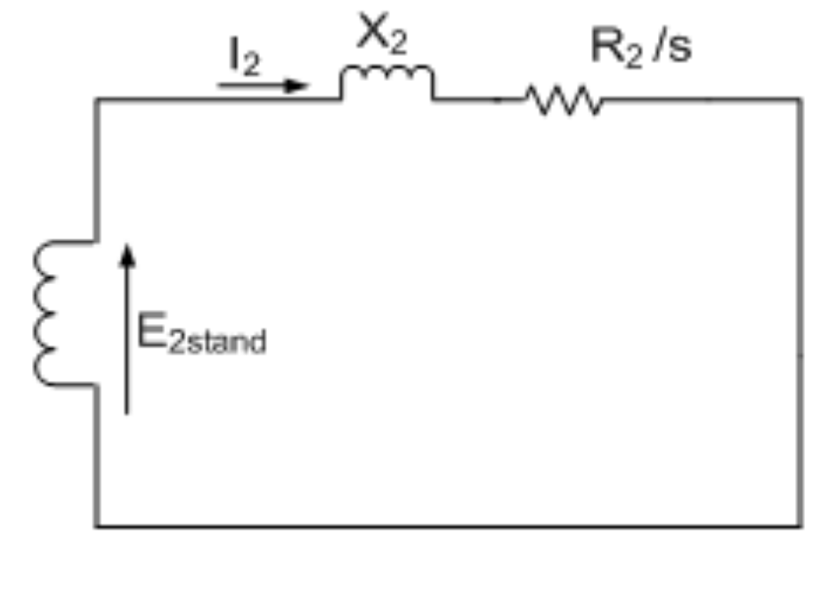
Exact equivalent circuit cont’d
The rotor circuit can be redrawn as
The significance of this rotor circuit is that it represents the rotating rotor by a fictitious stationary rotor with a constant reactance (or frequency) but with a variable resistance.

Slide 82
Exact equivalent circuit cont’d
This fictitious stationary rotor carries the same current as the actual rotor, and thus, it produces the same mmf wave.
With the rotor represented this way, it is now possible to transfer the secondary (rotor) impedance to the primary (stator) side in the same way as for transformer with the secondary short-circuited.

Slide 83
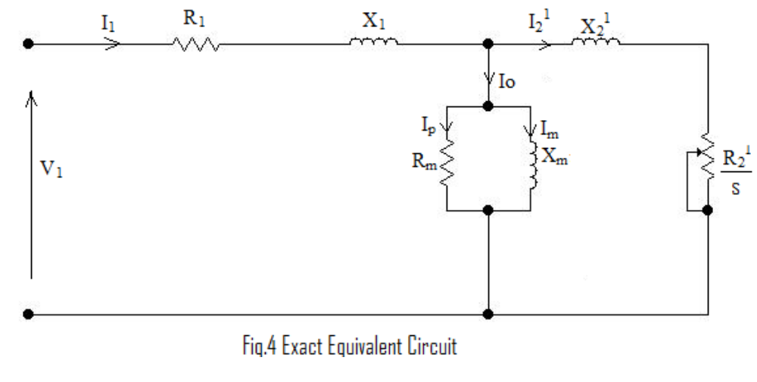
Exact equivalent circuit cont’d
The equivalent circuit referred to the stator is

Slide 84
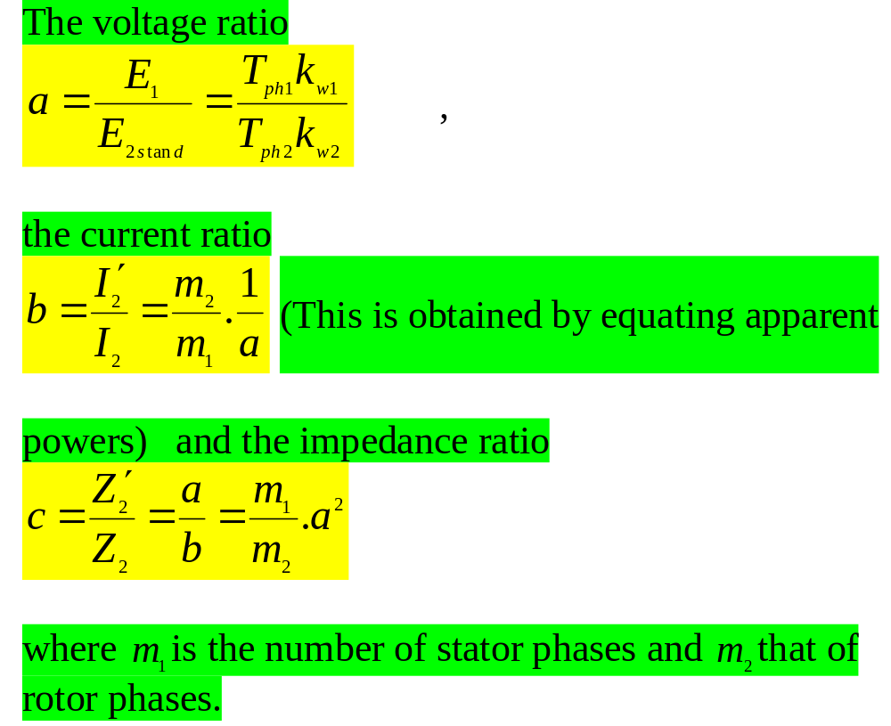

Slide 85
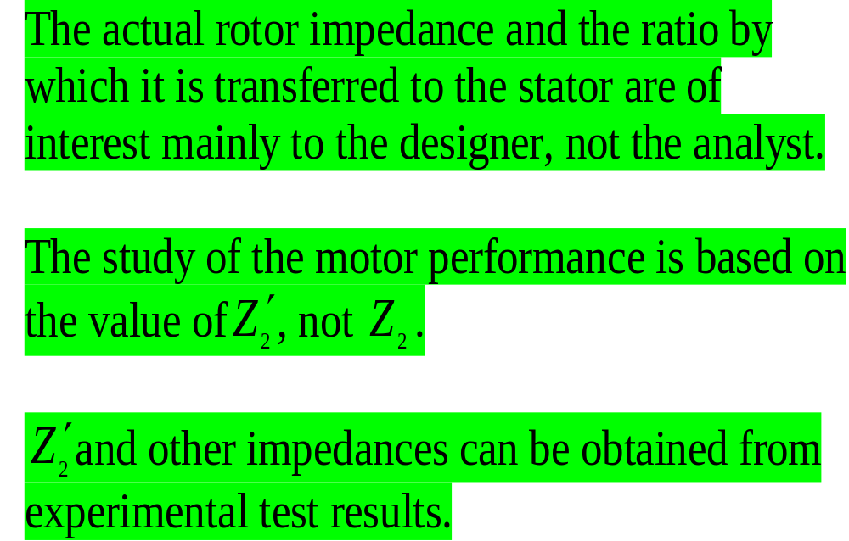
Exact equivalent circuit cont’d

Slide 86
Approximate circuits
A variety of performance characteristics can be estimated simply, and with reasonable accuracy using approximate circuits.
Two of such circuits are as follows:

Slide 87
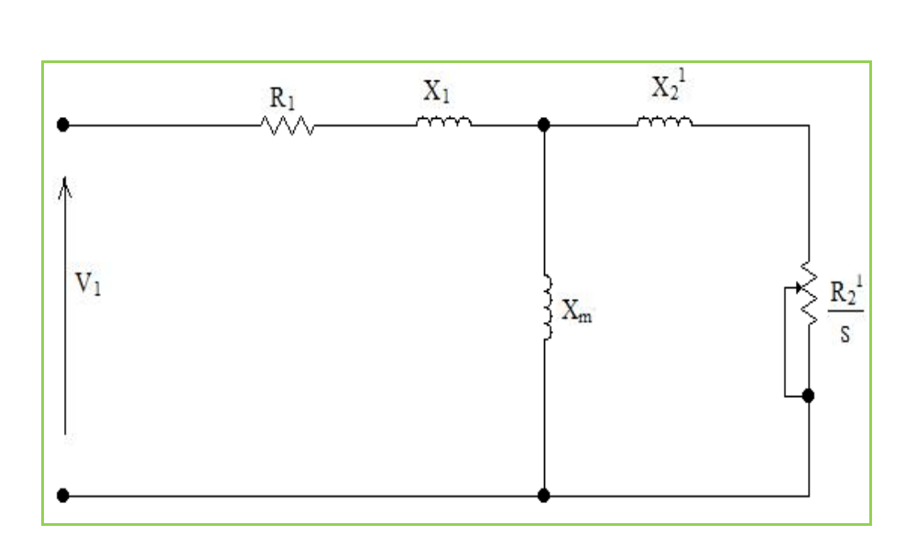

Slide 88
This circuit on the previous slide is IEEE recommended equivalent circuit.
The core loss is lumped with the mechanical losses.
Lumped together the losses are referred to as rotational losses.

Slide 89
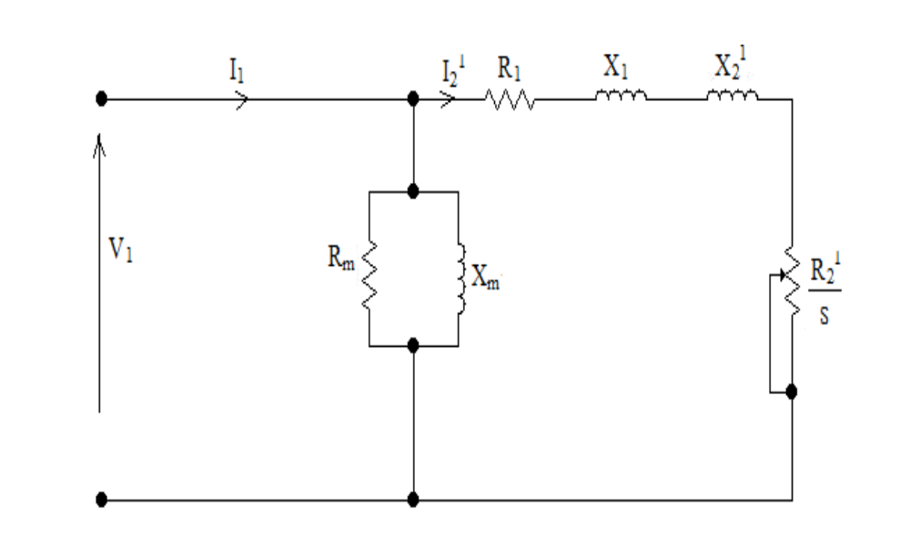

Slide 90
The voltage drop due to I_{o} flowing through the stator leakage impedance is appreciable.
Its exclusion in the circuit on the previous slide, can give rise to errors of 10 % or more in some cases.
It is acceptable for motors above 5 hp or 3 kW.

Slide 91
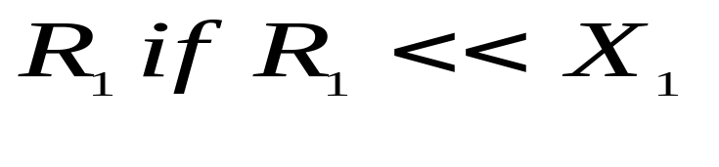
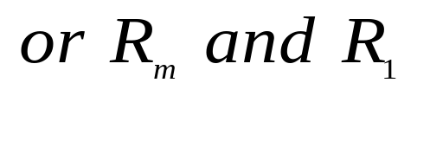
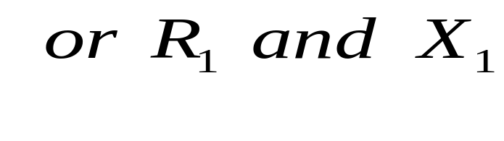
Approximate circuits cont’d.
Other approximations can be derived from the exact equivalent circuit by omitting
The last one implies that the mutual flux is constant. This gives very large errors at high values of slip.

Slide 92
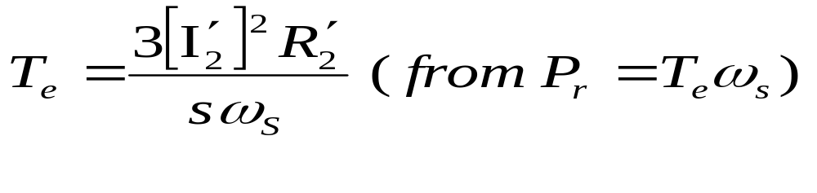
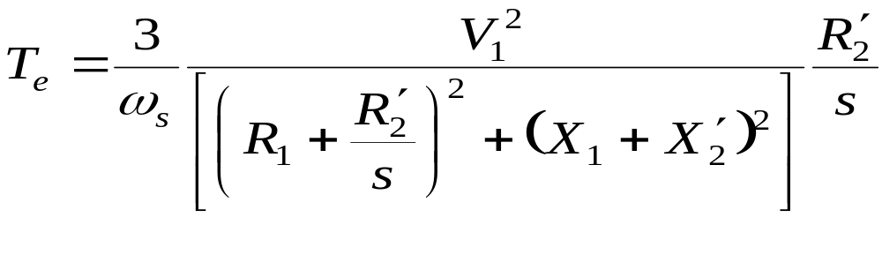
Torque calculations
The torque is given by
Consider approximate circuit no. 2.
In terms of the circuit parameters the torque is given by

Slide 93
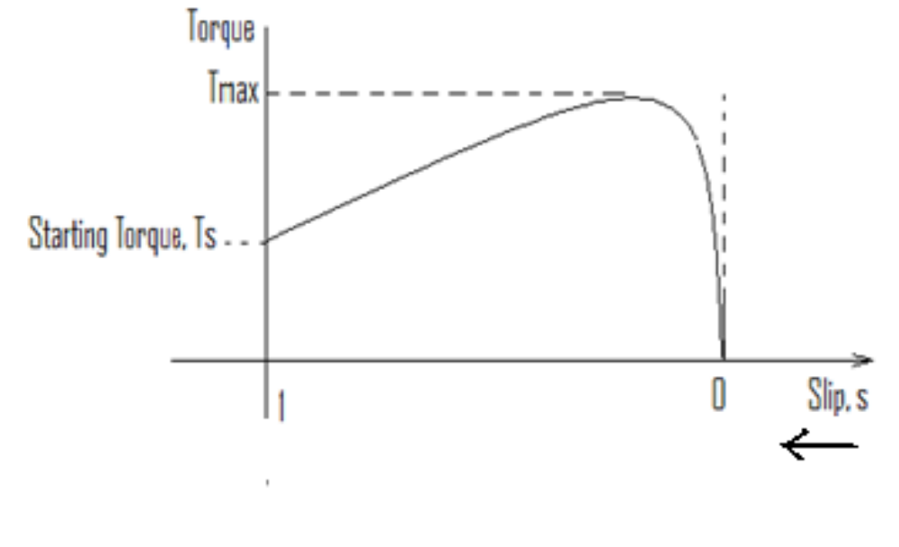
Torque calculations cont’d.
The general shape of the torque-slip curve for an induction motor is

Slide 94
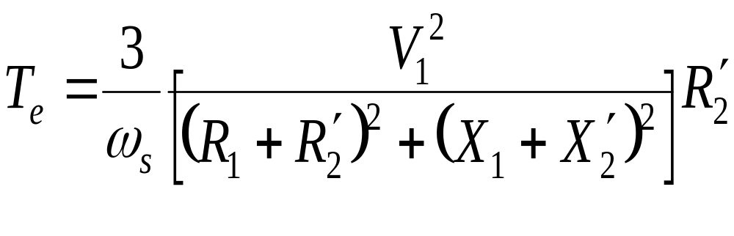
Torque calculations cont’d.
Starting torque
At starting s =1 and
For a given starting torque there are two possible values of rotor resistance. Why?

Slide 95
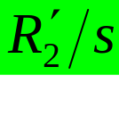
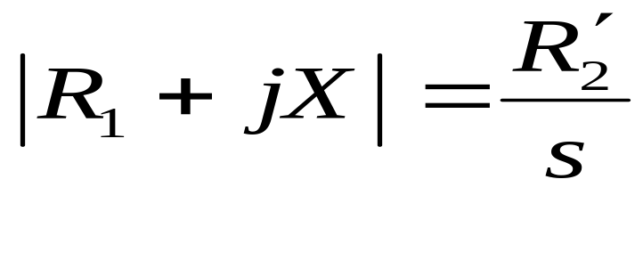
Maximum torque (T_{max} )
T_{max} is called the breakdown torque
To obtain the slip at which the maximum torque occurs, we use the fact that the torque is maximum when the power dissipated in is maximum and then apply the maximum power transfer theorem:

Slide 96
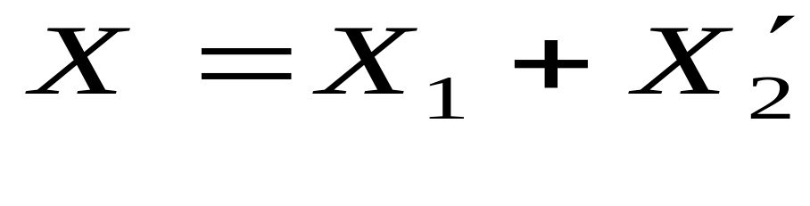
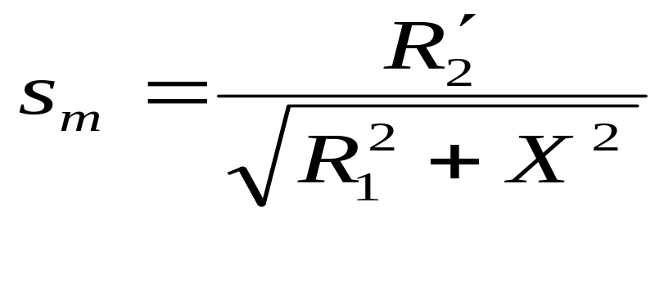
Maximum torque (T_{max} ) cont’d
Where
Thus the slip s_{m} at which maximum torque occurs is given by

Slide 97
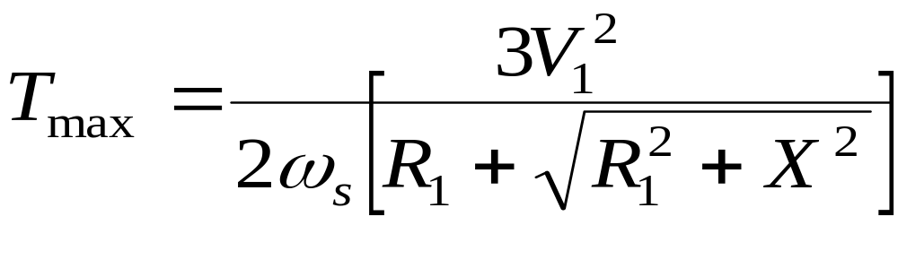
Maximum torque (T_{max} )cont’d
From s_{m} and the general torque equations, the value of maximum torque T_{max} is obtained as

Slide 98
Maximum torque (T_{max} )cont’d
We make the following observations:
  s_{m} is proportional to the rotor resistance but T_{max} does not depend on it.
  the speed of an induction motor can be controlled by varying the rotor resistance
  the starting torque can be increased by increasing the rotor resistance.

Slide 99
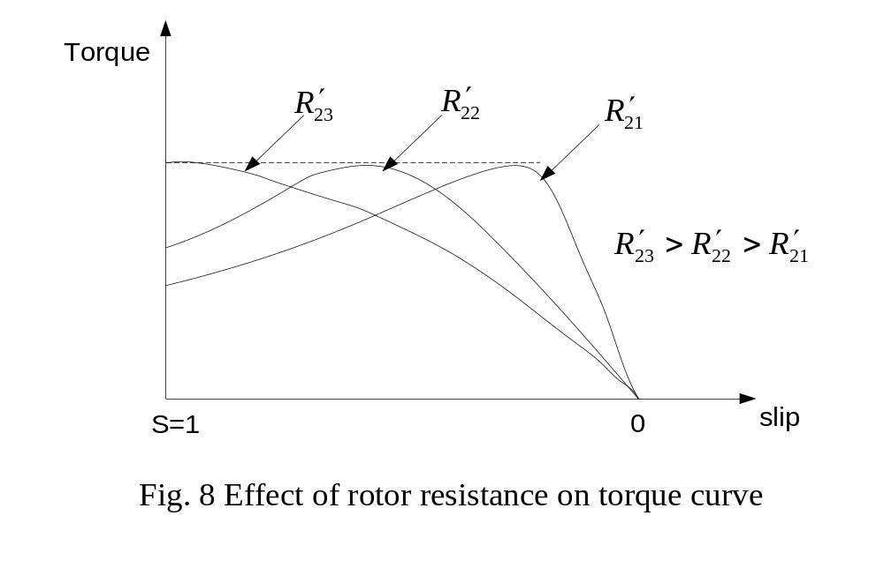
Typical torque-slip curves with variable rotor resistance are shown below:

Slide 100
Beyond R’₂₃ the starting torque starts decreasing. Thus for a given starting torque we notice here too that there are two possible values of rotor resistance.
The smaller rotor resistance is used to give larger accelerating torque at starting.
With a motor having a low-resistance rotor, such as the usual type of cage rotor, the starting torque is small compared with the maximum torque available.

Slide 101
Comparison of cage and slip-ring motors
Advantages of squirrel-cage motors
Cheaper and more robust
Slightly higher efficiency and power factor
Explosion proof, since the absence of slip-rings and brushes eliminate risk of sparking

Slide 102
Comparison of cage and slip-ring motors cont’d
Advantages of slip-ring motors
The starting torque is much higher and the starting current much lower
The speed can be varied by means of external rotor resistor

Slide 103
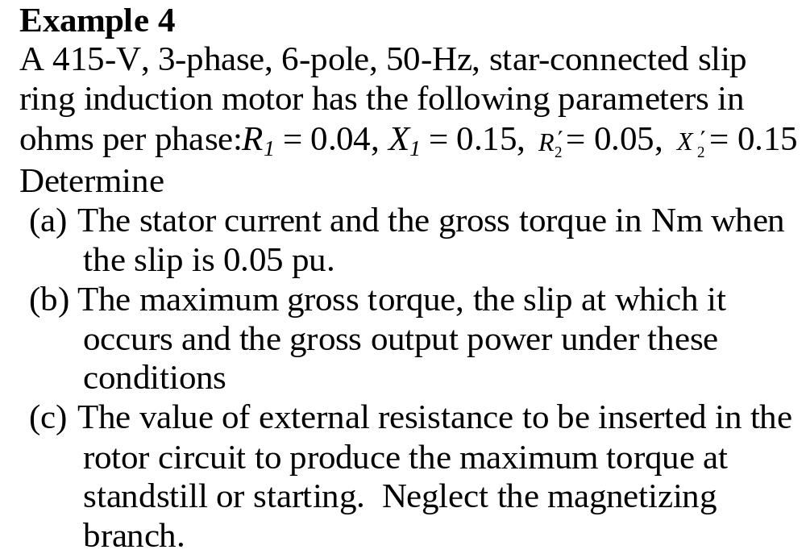

Slide 104
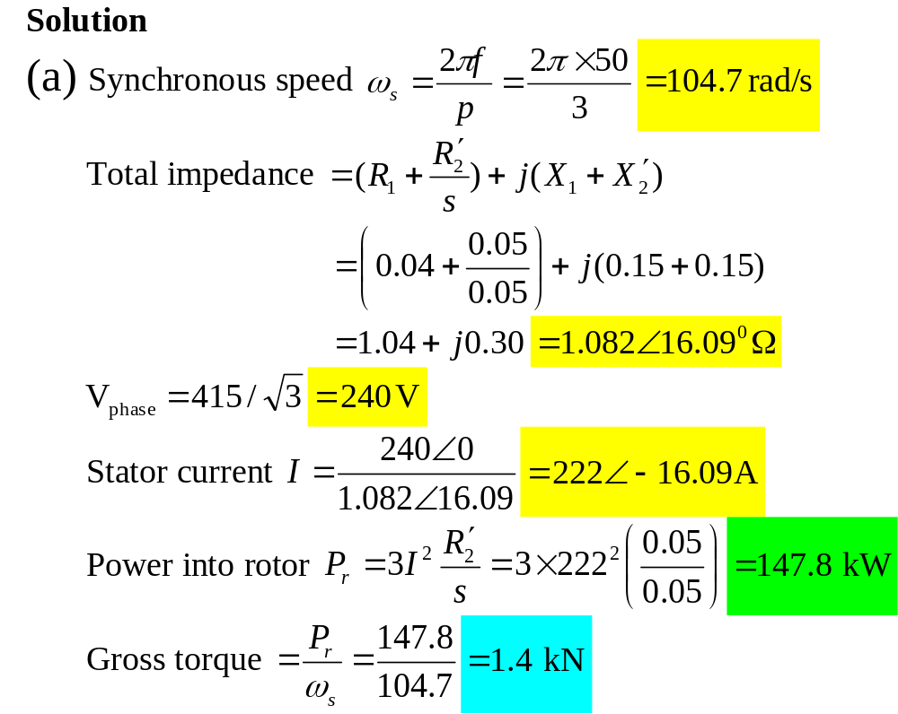

Slide 105
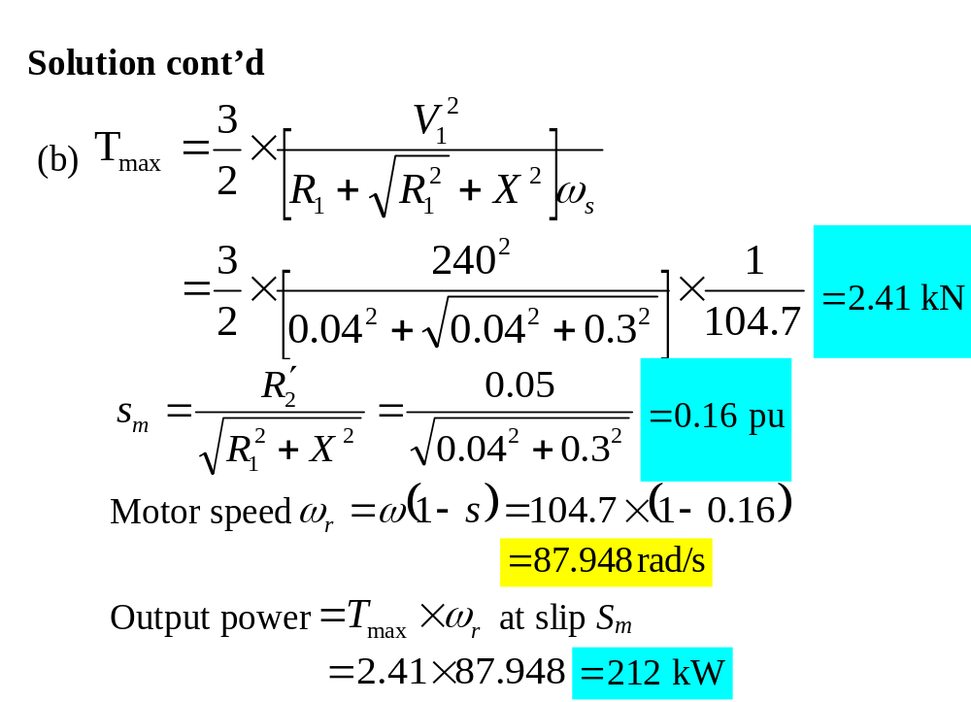

Slide 106
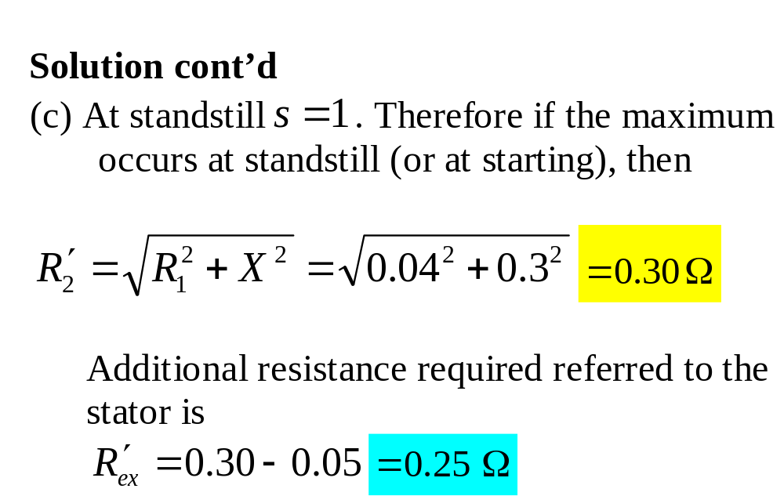

Slide 107
Determination of equivalent circuit parameters
The parameters of the motor equivalent circuit are determined from
  the measurement of dc phase resistance,
  and the locked rotor
  and the no load tests as follows:

Slide 108


Slide 109


Slide 110


